Slide 1
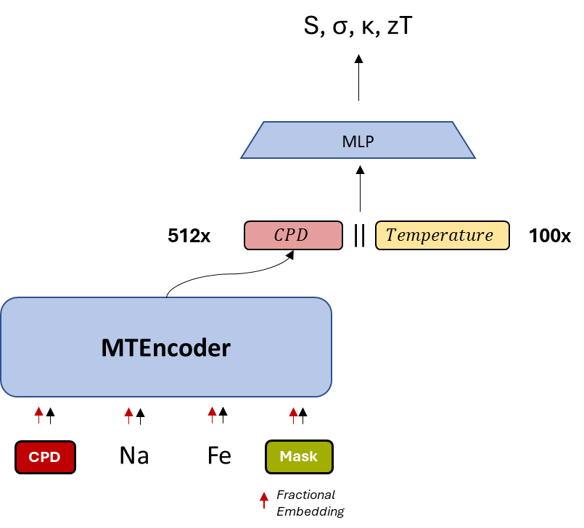
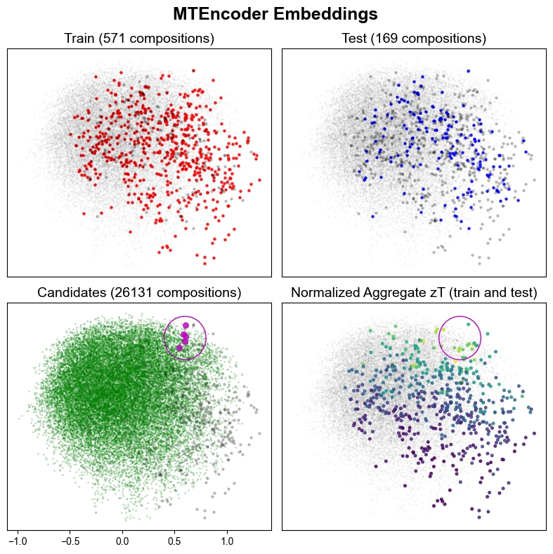
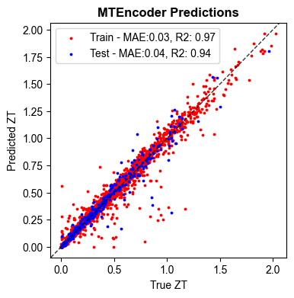
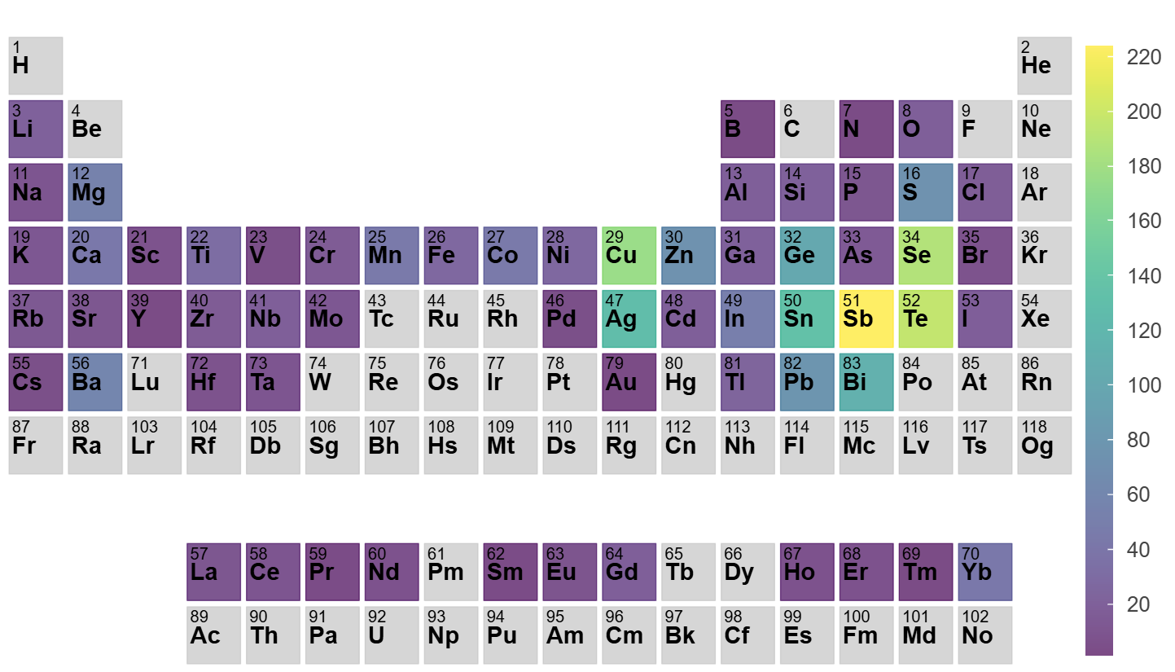
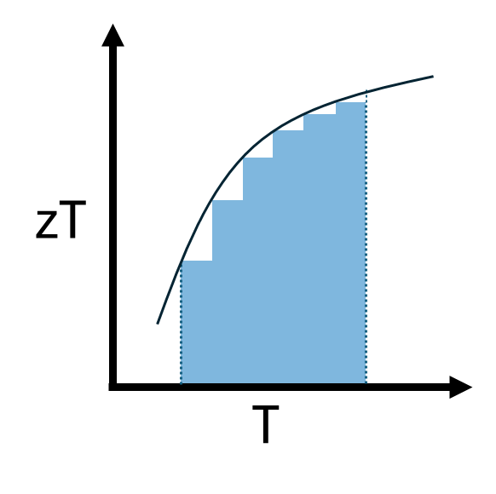
Ge_{1-xyz}A_{x}B_{y}C_{z}Te
Ge_{0.5}Ag_{0.1}Sb_{0.3}Bi_{0.1}Te
Ge_{0.5}Ag_{0.3}Sb_{0.1}Bi_{0.1}Te
Ge_{0.5}Ag_{0.1}Al_{0.1}Sb_{0.3}Te
Ge_{0.5}Sb_{0.3}Bi_{0.1}Y_{0.1}Te
Ge_{0.5}Al_{0.1}Sb_{0.3}Bi_{0.1}Te

Slide 2


S, σ, κ, zT
MLP
512x
$$CPD$$
||
$$Temperature$$
100x
zT
MTEncoder
T
Na
Fe
O
CPD
Mask
Fractional Embedding

